Slide 1
E-Business, E-Commerce and Business Applications

Slide 2
Enterprise Business Systems
E-business means using the Internet, other networks, and IT to support
  Electronic commerce
  Enterprise communications and collaboration
  Web-enabled business processes
E-commerce is the buying, selling, and marketing of products, services, and information over the Internet and other networks
Chapter 7 Electronic Business Systems

Slide 3
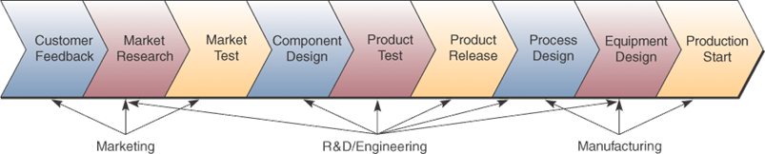
Cross-Functional Systems
Cross the boundaries of traditional business functions / processes
  Used to reengineer and improve vital business processes all across the enterprise
Chapter 7 Electronic Business Systems

Slide 4
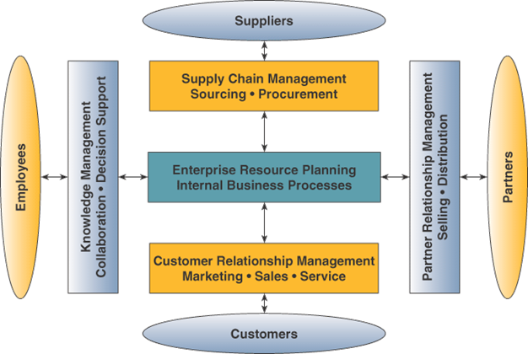
Enterprise Application Architecture
Chapter 7 Electronic Business Systems

Slide 5
Enterprise Application Architecture
Provides a conceptual framework
  Helps visualize the basic components, processes, and interfaces of major e-business applications
Focuses on accomplishing fundamental
business processes in concert with
  Customers
  Suppliers
  Partners
  Employees
Chapter 7 Electronic Business Systems

Slide 6
Enterprise Application Architecture
Enterprise Resource Planning (ERP)
  Concentrates on the efficiency of internal production, distribution, and financial processes
Customer Relationship Management (CRM)
  Focuses on acquiring and retaining profitable customers via marketing, sales, and services
Partner Relationship Management (PRM)
  Aims at acquiring and retaining partners who
  can enhance the selling and distribution of products and services
Chapter 7 Electronic Business Systems

Slide 7
Enterprise Application Architecture
Supply Chain Management (SCM)
  Focuses on developing the most efficient and effective sourcing and procurement processes
Knowledge Management (KM)
  Focuses on facilitating internal group collaboration and decision support
Chapter 7 Electronic Business Systems

Slide 8
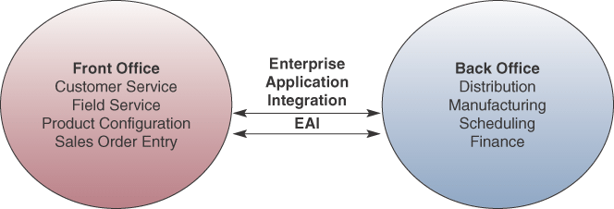
Enterprise Application Integration
Connects cross-functional systems
Serves as middleware to provide
  Data conversion
  Communication between systems
  Access to system interfaces
Chapter 7 Electronic Business Systems

Slide 9
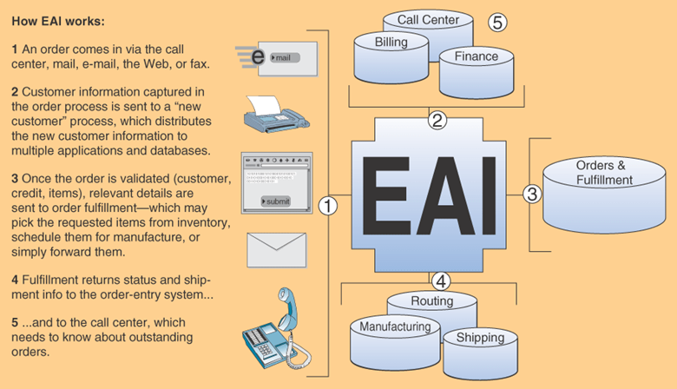
How EAI Works
Chapter 7 Electronic Business Systems

Slide 10
Enterprise Collaboration Systems (ECS)
EC systems are cross-functional information systems that enhance team and workgroup
  Communication
  Coordination
  Collaboration
Systems may include
  Networked PC workstations
  Servers
  Databases
  Groupware and application packages
Chapter 7 Electronic Business Systems

Slide 11
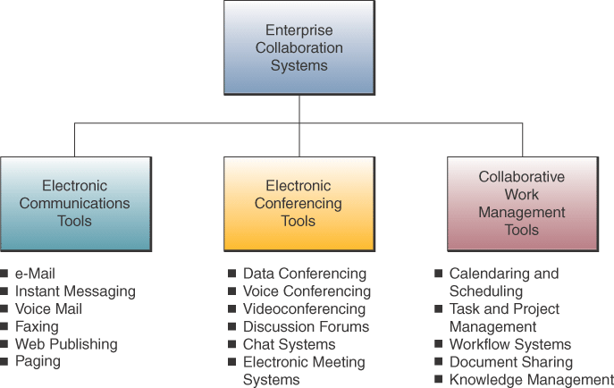
ECS Tools
Chapter 7 Electronic Business Systems

Slide 12
Functional Business Systems
A variety of types of information systems
that support the business functions of
  Accounting
  Finance
  Marketing
  Operations management
  Human resource management
Chapter 7 Electronic Business Systems

Slide 13
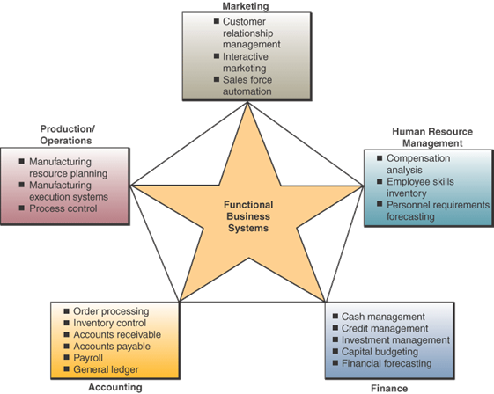
IT in Business
Chapter 7 Electronic Business Systems

Slide 14
Introduction to e-Commerce
Electronic commerce encompasses the entire online process of
  Developing
  Marketing
  Selling
  Delivering
  Servicing
  Paying for products and services
It relies on the Internet and other information technologies to support every step of the process
Chapter 9 Electronic Commerce Systems

Slide 15
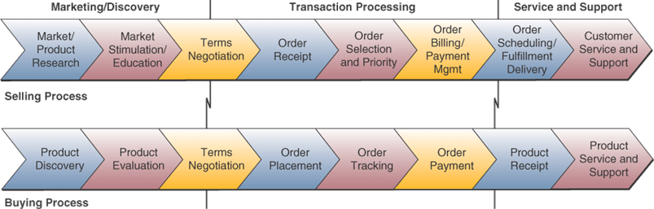
The Scope of e-Commerce
Chapter 9 Electronic Commerce Systems

Slide 16
Categories of e-Commerce
Business-to-Consumer
  Virtual storefronts, multimedia catalogs, interactive order processing, electronic payment, online customer support
Business-to-Business
  Electronic business marketplaces, direct links between businesses, auctions and exchanges
Consumer-to-Consumer
  Online auctions, posting to newspaper sites, personal websites, e-commerce portals
Chapter 9 Electronic Commerce Systems

Slide 17
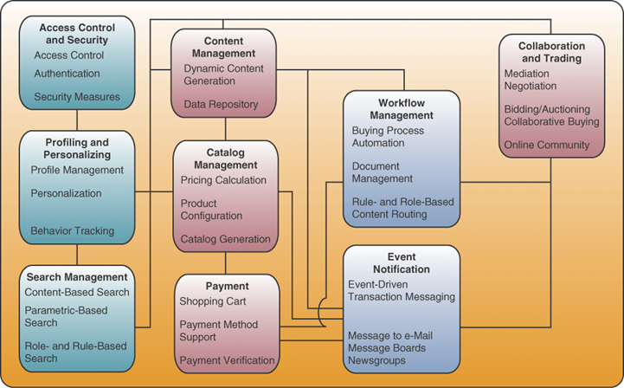
Essential e-Commerce Architecture
Chapter 9 Electronic Commerce Systems

Slide 18
Access Control and Security
E-commerce processes must establish mutual trust and secure access between parties
  User names and passwords
  Encryption key
  Digital certificates and signatures
Restricted access areas
  Other people’s accounts
  Restricted company data
  Webmaster administration areas
Chapter 9 Electronic Commerce Systems

Slide 19
Profiling and Personalizing
Profiling gathers data on you and your website behavior and choices
  User registration
  Cookie files and tracking software
  User feedback
Profiling is used for
  Personalized (one-to-one) marketing
  Authenticating identity
  Customer relationship management
  Marketing planning
  Website management
Chapter 9 Electronic Commerce Systems

Slide 20
Search Management
Search processes help customers find the specific product or service they want
  E-commerce software packages often include
  a website search engine
  A customized search engine may be acquired from companies like Google or Requisite Technology
  Searches are often on content or by parameters
Chapter 9 Electronic Commerce Systems

Slide 21
Content and Catalog Management
Content Management Software
  Helps develop, generate, deliver, update, and archive text and multimedia information at
  e-commerce websites
Catalog Management Software
  Helps generate and manage catalog content
Catalog and content management software works with profiling tools to personalize content
  Includes product configuration and
  mass customization
Chapter 9 Electronic Commerce Systems

Slide 22
Workflow Management
E-business and e-commerce workflow management depends on a workflow software engine
  Contains software model of business processes
Workflow models express predefined
  Sets of business rules
  Roles of stakeholders
  Authorization requirements
  Routing alternative
  Databases used
  Task sequences
Chapter 9 Electronic Commerce Systems

Slide 23
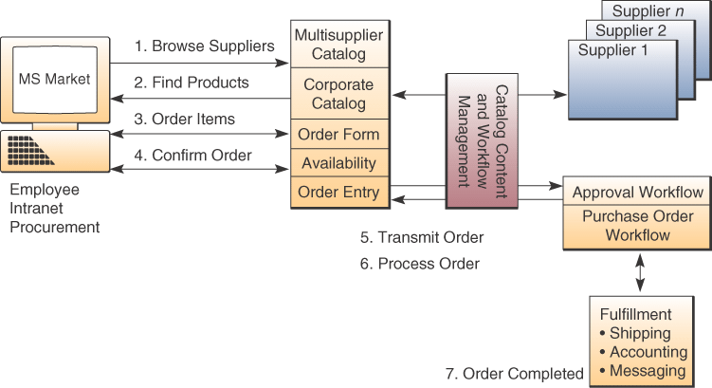
Example of Workflow Management
Chapter 9 Electronic Commerce Systems

Slide 24
Event Notification
Most e-commerce applications are event driven
  Responds to such things as customer’s first website visit and payments
  Monitors all e-commerce processes
  Records all relevant events, including problem situations
  Notifies all involved stakeholders
  Works in conjunction with user-profiling software
Chapter 9 Electronic Commerce Systems

Slide 25
Electronic Payment Processes
Complex processes
  Near-anonymous and electronic nature
  of transactions
  Many security issues
  Wide variety of debit and credit alternatives
  Financial institutions may be part of the process
Chapter 9 Electronic Commerce Systems

Slide 26
Electronic Payment Processes
Web Payment Processes
  Shopping cart process
  Credit card payment process
  Debit and other more complex processes
Electronic Funds Transfer (EFT)
  Major payment system in banking, retail
  Variety of information technologies capture
  and process money and credit card transfers
  Most point-of-sale terminals in retail stores
  are networked to bank EFT systems
Chapter 9 Electronic Commerce Systems

Slide 27
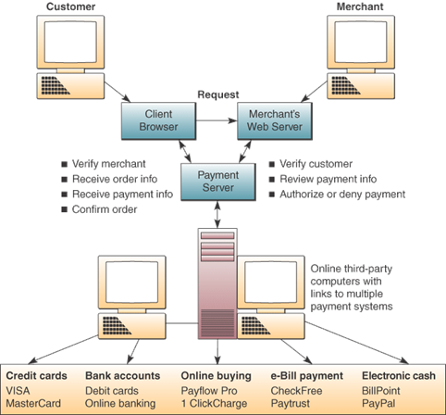
Electronic Payment Example
Chapter 9 Electronic Commerce Systems

Slide 28
Securing Electronic Payments
Network sniffers easily recognize credit card formats
  Encrypt data between customer and merchant
  Encrypt data between customer and financial institution
  Take sensitive information off-line
Chapter 9 Electronic Commerce Systems

Slide 29
E-Commerce Success Factors
Some of the success factors in e-commerce
  Performance and service
  Look and feel
  Advertising and incentives
  Personal attention (one-to-one marketing)
  Community relationships
  Security and reliability
Chapter 9 Electronic Commerce Systems

Slide 30
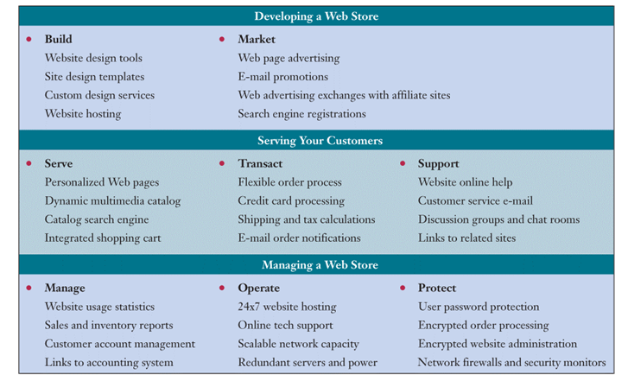
Web Store Requirements
Chapter 9 Electronic Commerce Systems

Slide 31
Developing a Web Store
Build a website
  Choose or set up web hosting
  Use simple design tools and templates
  Include a shopping cart and payment support
Market the website
  Include Web page and e-mail advertising
  and promotions
  Exchange advertising with other Web stores
  Register with search engines and directories
Chapter 9 Electronic Commerce Systems

Slide 32
Serving Your Customers
Convert visitors into loyal customers
  Develop one-to-one relationship with customers
  Create incentives to encourage registration
  Use Web cookies to identify visitors
  Use tracking services to record and analyze website behavior and customer preferences
  Create an attractive, friendly, efficient store
  Offer fast order processing and payment
  Notify when orders are processed and shipped
  Provide links to related websites
Chapter 9 Electronic Commerce Systems

Slide 33
Managing a Web Store
Manage both the business and the website
  Record and analyze traffic, inventory, sales
  Use CRM features to help retain customers
  Link sales, inventory data to accounting systems
Operate 24 hours a day, seven day a week
Protect transactions and customer records
  Use security monitors and firewalls
  Use redundant systems and power sources
  Employ passwords and encryption
  Offer 24-hour tech support
Chapter 9 Electronic Commerce Systems

